Slide 1
Machine Learning
ML is a branch of artificial intelligence:
•Uses computing based systems to make sense out of data
•Extracting patterns, fitting data to functions, classifying data, etc
•ML systems can learn and improve
•With historical data, time and experience
•Bridges theoretical computer science and real noise data.

Slide 2
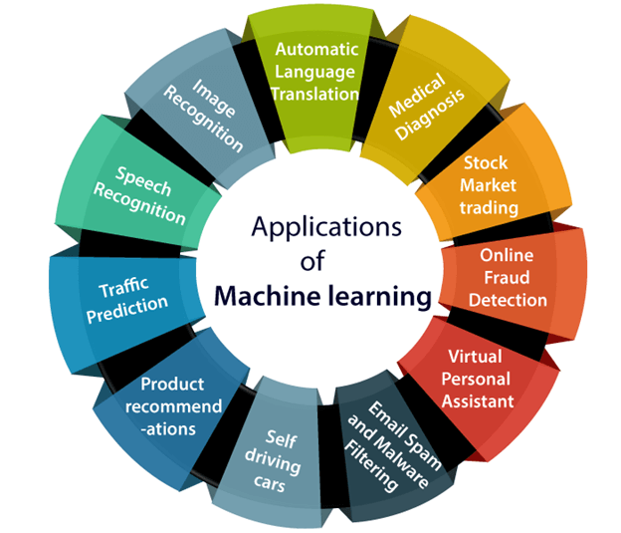
ML in real life
Machine learning is a buzzword for today's technology, and it is growing very rapidly day by day. We are using machine learning in our daily life even without knowing it such as Google Maps, Google assistant, Alexa, etc. Below are some most trending real-world applications of Machine Learning

Slide 3
Difference between supervised and unsupervised learning
-Supervised learning- for each observation of the predictor measurement(s) x(i), i = 1,...,n there is an associated response measurement y(i)
-We use regression, classification based algorithms
-The machine ls already fed with the required feature set to classify between inputs (hence the term 'supervísed')
-Unsupervised learning- for every observation i = 1,...,n, we observe a vector of measurements x(i)but no associated response y(i)
-We use clustering, feature extraction based algorithms,
-The machine needs to figure out the output on its own by identifying patterns in the raw data provided to it

Slide 4
ML as a Process: Model Building
Data Splitting
•Allocate data to different tasks
•model training
•performance evaluation
•Define Training, Validation and Test sets
Feature Selection (Review the decision made previously)
Estimating Performance
•Visualization of results – discovery interesting areas of the problem space
•Statistics and performance measures
Evaluation and Model selection
•The ‘no free lunch’ theorem no a priory assumptions can be made
•Avoid use of favorite models if NEEDED

Slide 5
Linear Regression
Linear regression is one of the most popular Machine Learning algorithms. It is a statistical method that is used for predictive analysis. Linear regression makes predictions for continuous/real or numeric variables such as sales, salary, age, product price, etc.
Linear regression algorithm shows a linear relationship between a dependent (y) and one or more independent (y) variables, hence called as linear regression. Since linear regression shows the linear relationship, which means it finds how the value of the dependent variable is changing according to the value of the independent variable.

Slide 6
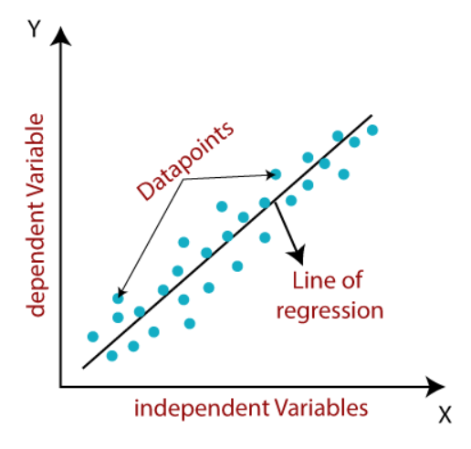
The linear regression model provides a sloped straight line representing the relationship between the variables. Consider the below image:
Types of Linear Regression
Linear regression can be further divided into two types of the algorithm:
Simple Linear Regression: If a single independent variable is used to predict the value of a numerical dependent variable, then such a Linear Regression algorithm is called Simple Linear Regression.
Multiple Linear regression: If more than one independent variable is used to predict the value of a numerical dependent variable, then such a Linear Regression algorithm is called Multiple Linear Regression.

Slide 7
Simple Linear Regression
Simple Linear Regression is the linear regression model with one independent variable and one dependent variable.
Example: Years of Experience vs Salary, Area vs House Price
Before building a simple linear regression model, we have to check the linear relationship between the two variables.
We can measure the strength of the linear relationship, by using a correlation coefficient

Slide 8
Motivation for Linear Regression
1. Is there a relationship between advertising budget and sales?
2. How strong is the relationship between advertising budget and sales?
3. Which media contribute to sales?
4. How accurately can we estimate the effect of each medium on sales?
5. How accurately can we predict future sales?

Slide 9




Linear Regression using a single predictor
• We assume a model:
where 𝛽0 and 𝛽1 are two unknown constants that represent the intercept and slope, also known as coefficients or parameters, and 𝜖 is the error term.
• Given some estimates for the model coefficients, we predict future sales using where indicates a prediction of Y on the basis of X = x.
The hat symbol denotes an estimated value.

Slide 10
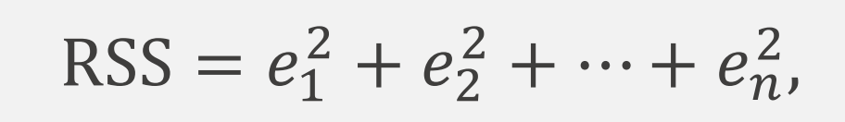
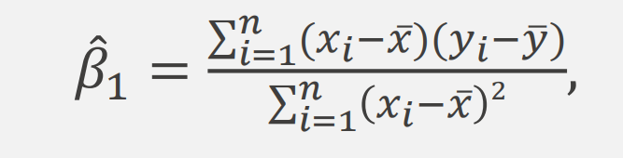
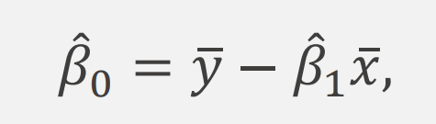
Estimation of parameters by least squares
We define the residual sum of squares (RSS) as:
or equivalently as
The least squares approach chooses to minimize the RSS. The minimizing values can be shown to be

Slide 11
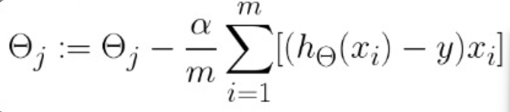
Gradient Descent
Gradient descent is an optimization algorithm used to minimize some function by iteratively moving in the direction of steepest descent as defined by the negative of the gradient. In machine learning, we use gradient descent to update the parameters of our model.A learning rate is used for each pair of input and output values. It is a scalar factor and coefficients are updated in direction towards minimizing error. The process is repeated until a minimum sum squared error is achieved or no further improvement is possible.
In short ,it is a minimization algorithm meant for minimizing a given activation function.

Slide 12
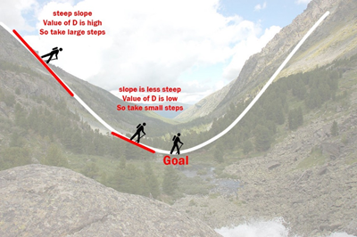
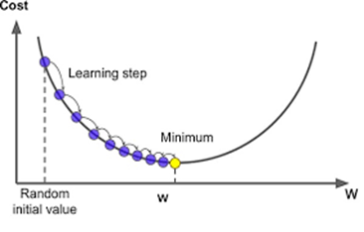
To understand this in simple terms, let us see an example on how it works…
Imagine a valley and a person with no sense of direction
who wants to get to the bottom of the valley.
He goes down the slope and takes large steps
when the slope is steep and small steps
when the slope is less steep.
He decides his next position based on his current position
and stops when he gets to the bottom
of the valley which was his goal.

Slide 13
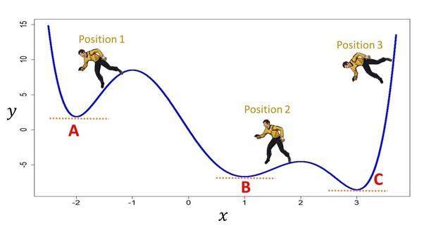
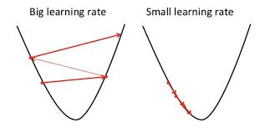
When the learning rate is quite high, the process will be a very haphazard one. So, the smaller the learning rate, the better the result of the model will be.
NOTE: In the case of linear regression model, there is only one minimum and it is the global minimum. Hence we say that the required coefficients for the line is found.
In such case (as above example figure), the local minimum reached depends on the initial coefficients taken into consideration. Here, point A, B are termed Local Minimum and point C is Global Minimum.

Slide 14
Gradient Descent
Gradient descent is used to minimize the MSE by calculating the gradient of the cost function.
A regression model uses gradient descent to update the coefficients of the line by reducing the cost function.
It is done by a random selection of values of coefficient and then iteratively update the values to reach the minimum cost function.

Slide 15
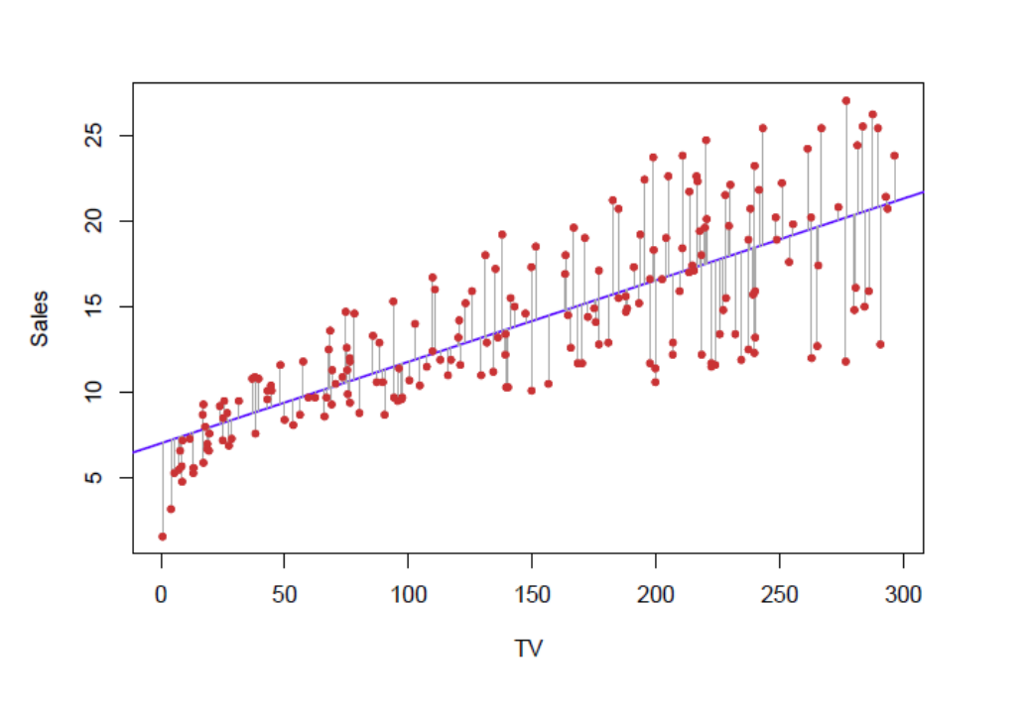
Example of Advertising Data
The least squares fit for the regression of sales onto TV. In this case a linear fit captures the essence of the relationship, although it is somewhat deficient in the left of the plot.

Slide 16
What is Classification ?
• Classification is a process of categorizing a given set of data into classes.
• The process starts with predicting the class of given data points. The classes are often referred to as target, label or categories.
• The classification predictive modeling is the task of approximating the mapping function from input variables to discrete output variables. The main goal is to identify which class/category the new data will fall into.

Slide 17
Use cases of classification
How can we classify covid-19 from other respiratory diseases? Like fever, loss of smell, shortness of breath.
How researchers classify whether a tumor is malignant or not? Like nature of tumor, affected body area, family history.
How does show particular content? Like ads on which users clicked recently, frequently visited sites.

Slide 18

Logistic Regression
• Logistic Regression is used for classification problems i.e where the response is qualitative or categorical. For example: binary classification problems.
• The ‘sigmoid’ function that is used for logistic regression is as follows:

Slide 19
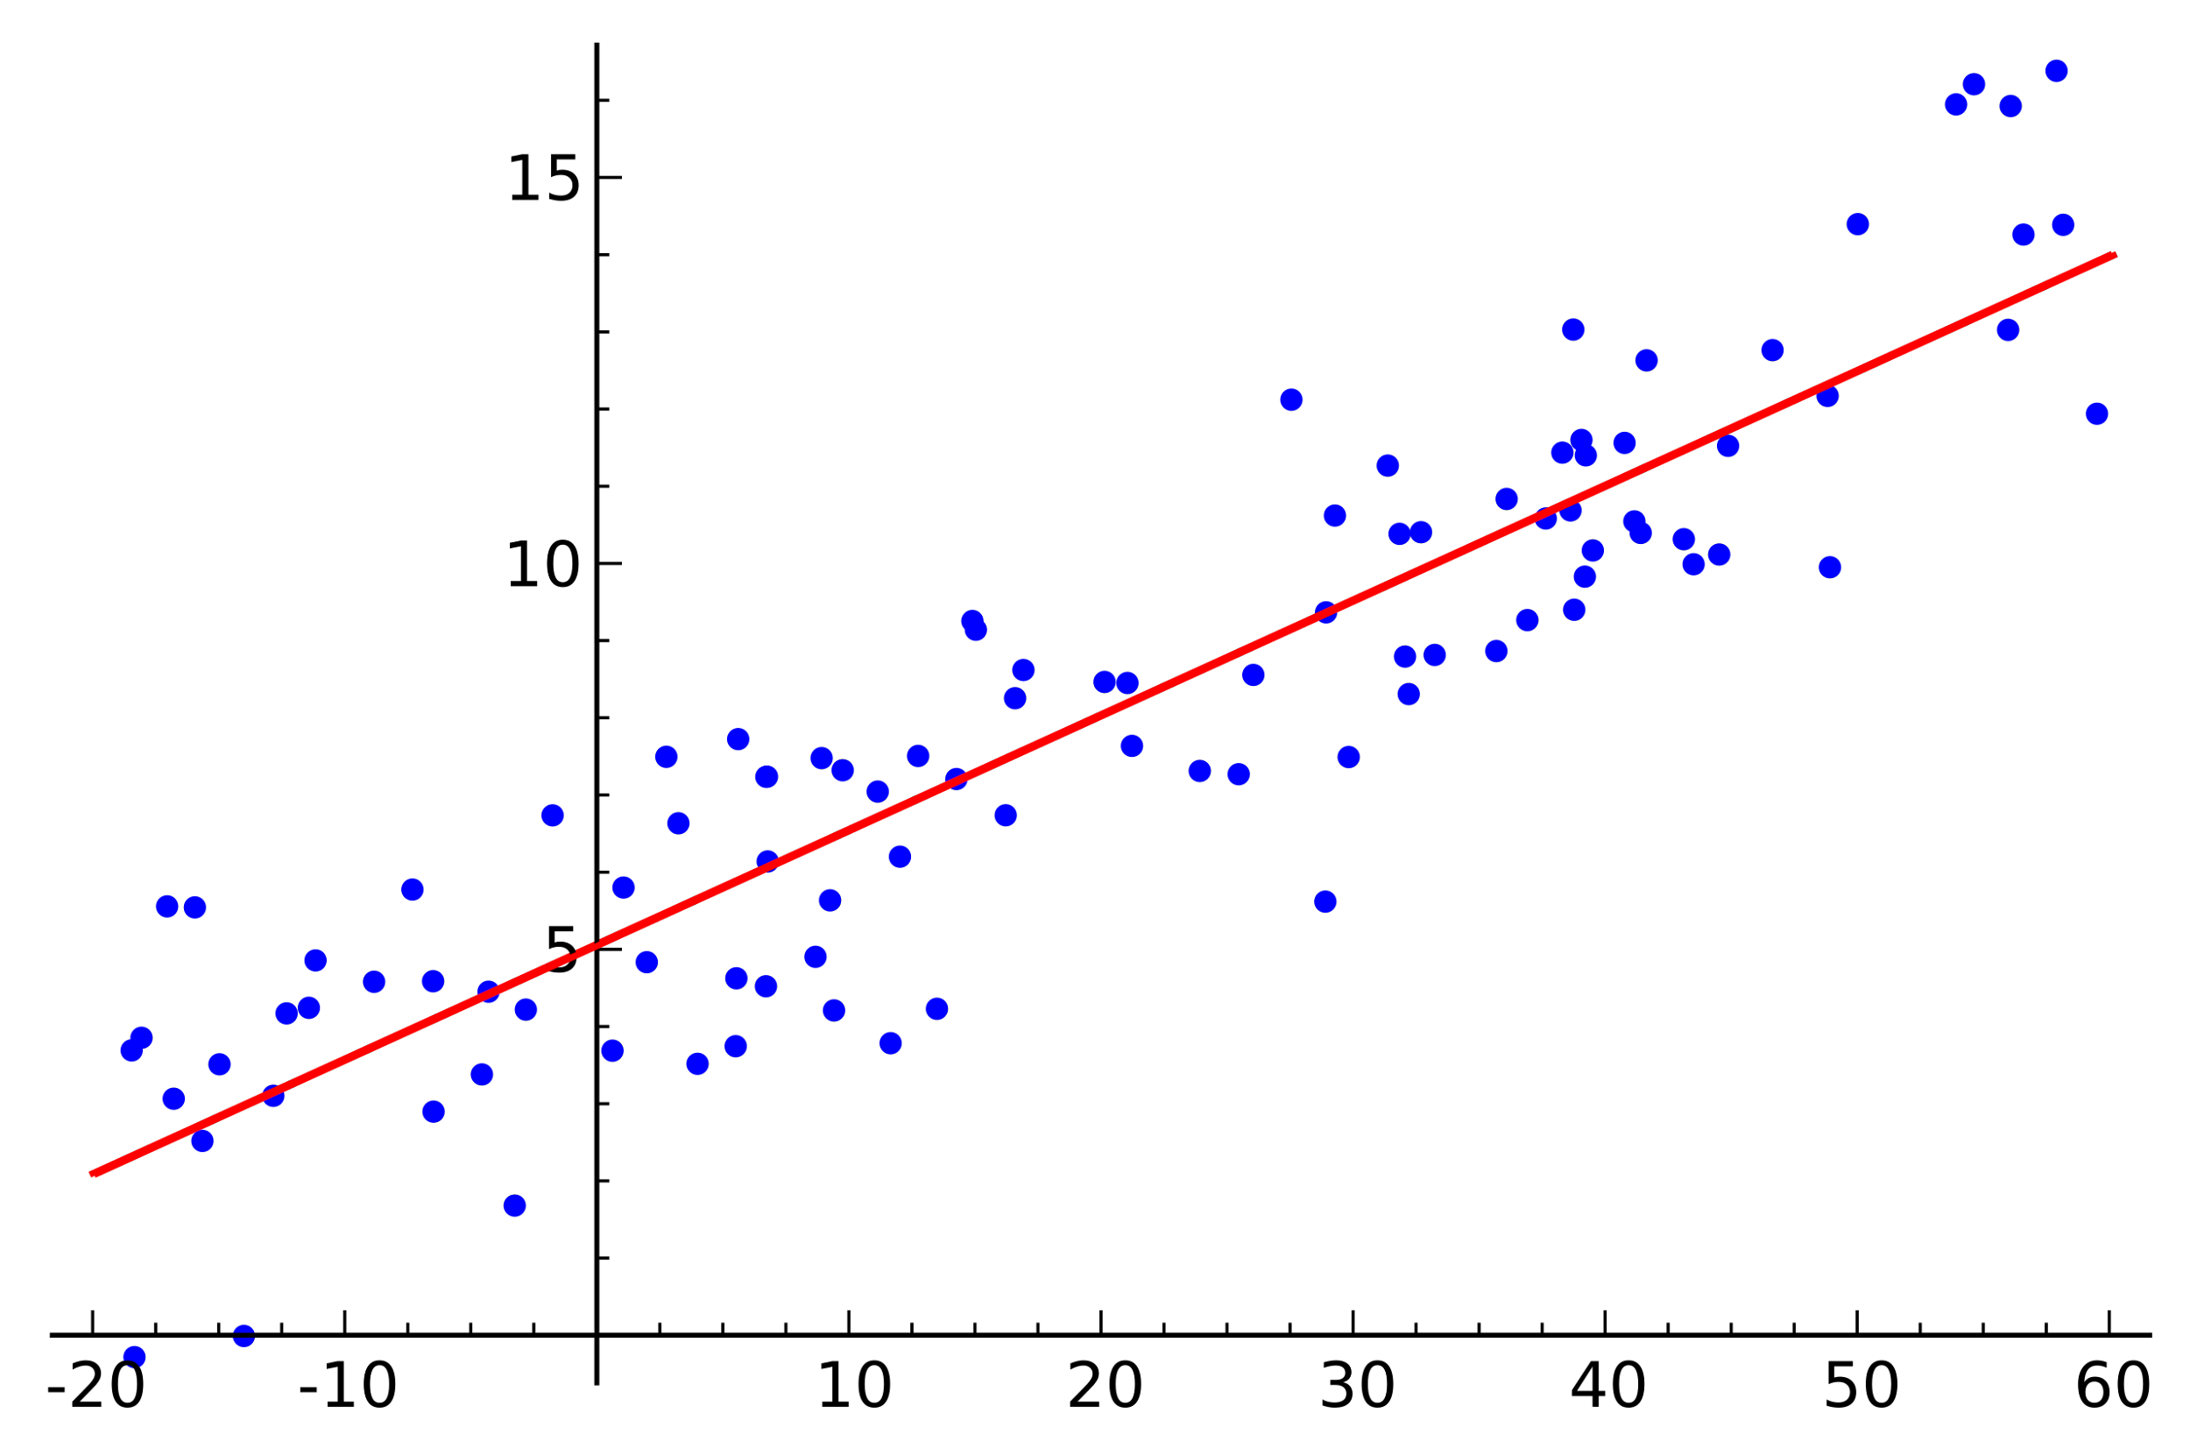
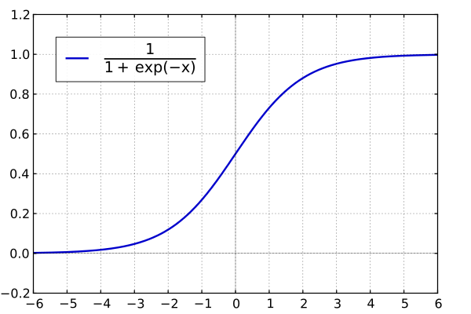
Why not use linear regression?
• Linear regression is the type of regression we use for a continuous, normally distributed response variable.
• Logistic regression is the type of regression we use for a binary response variable that follows a Bernoulli distribution

Slide 20
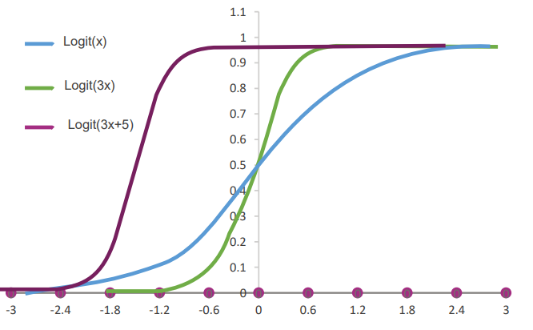
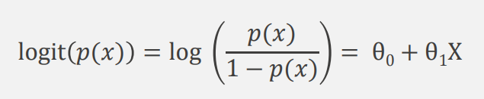

Logistic Regression Model
• Let Y be a binary outcome and X a predictor.
• We are interested in modelling px = P(Y=1|X=x), i.e. the probability of success for the predictor value of X= x.
Define the Logistic Regression model as:

Slide 21

Loss/Cost Function
The loss function for linear regression is squared loss. The loss function for logistic regression is Log Loss, which is defined as follows:
Another advantage of this loss function is that although we are looking at it by y = 1 and y = 0 separately, it can be written as one single formula which brings convenience for calculation:

Slide 22
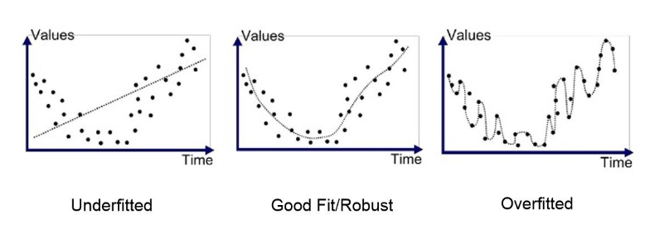
Need of Regularisation
o

Slide 23
KNN (K-Nearest Neighbour)
K-Nearest Neighbour is one of the simplest Machine Learning algorithms based on Supervised Learning technique.
K-NN algorithm assumes the similarity between the new case/data and available cases and put the new case into the category that is most similar to the available categories.
K-NN algorithm stores all the available data and classifies a new data point based on the similarity. This means when new data appears then it can be easily classified into a well suite category by using K- NN algorithm.
K-NN algorithm can be used for Regression as well as for Classification but mostly it is used for the Classification problems.
It is also called a lazy learner algorithm because it does not learn from the training set immediately instead it stores the dataset and at the time of classification, it performs an action on the dataset.

Slide 24
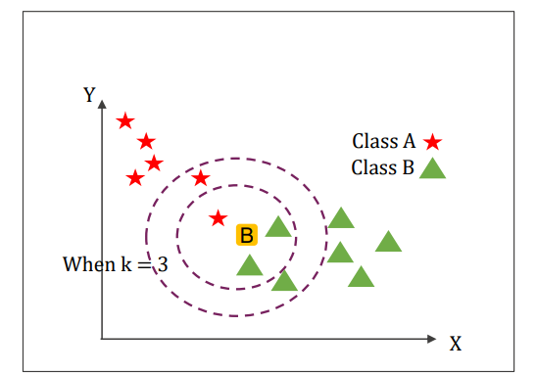
Basic approach behind KNN
• The KNN algorithm assumes that similar things exist in close proximity.
• KNN captures the idea of similarity by calculating the distance between closest points.

Slide 25
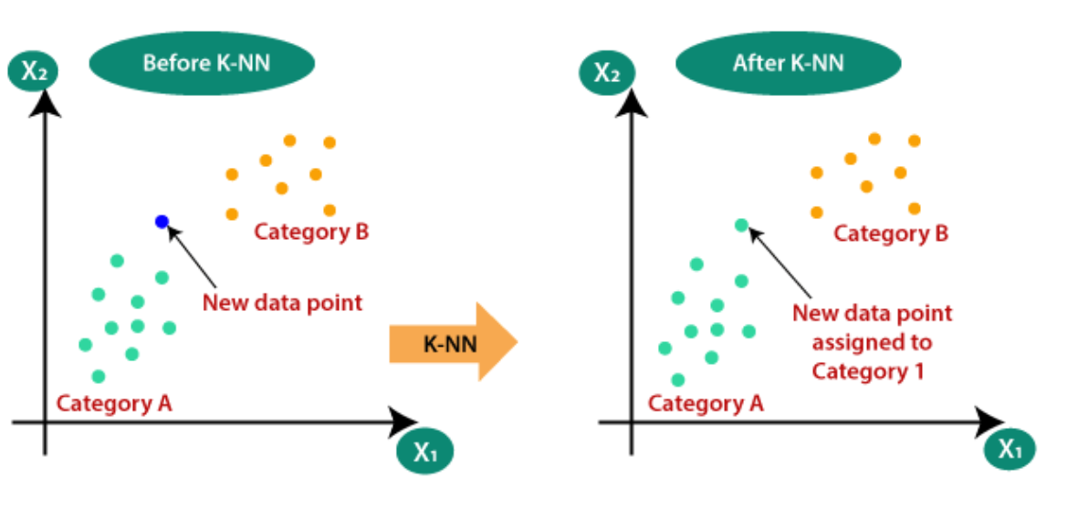
Why we need KNN?
Suppose there are two categories, i.e., Category A and Category B, and we have a new data point x1, so this data point will lie in which of these categories. To solve this type of problem, we need a K-NN algorithm. With the help of K-NN, we can easily identify the category or class of a particular dataset. Consider the below diagram:

Slide 26
How does K-NN work?
Step-1: Select the number K of the neighbors
Step-2: Calculate the Euclidean distance of K number of neighbors
Step-3: Take the K nearest neighbors as per the calculated Euclidean distance.
Step-4: Among these k neighbors, count the number of the data points in each category.
Step-5: Assign the new data points to that category for which the number of the neighbor is maximum.
Step-6: Our model is ready.

Slide 27
How to select the value of K in the K-NN Algorithm?
There is no particular way to determine the best value for "K", so we need to try some values to find the best out of them. The most preferred value for K is 5.
A very low value for K such as K=1 or K=2, can be noisy and lead to the effects of outliers in the model.
Large values for K are good, but it may find some difficulties.

Slide 28
Analysis of KNN
Advantages:-
1. The algorithm is simple and easy to implement.
2. There’s no need to build a model, tune several parameters, or make additional assumptions.
3. The algorithm is versatile. It can be used for classification in different use cases
Disadvantages:-
1. The algorithm gets significantly slower as the number of examples and/or predictors/independent variables increase.

